Slide 1



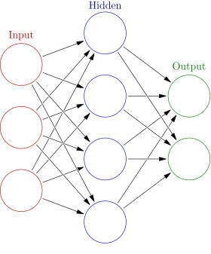
Neural Networks
Knowledge and solutions for a changing world
Advancing data-intensive discovery in all fields
Be boundless
Data Science Methods for Cutting-Edge Research (DSMCER)

Slide 2


Neural Networks
How does our brain recognize the photographer?
photographer
Picture
Retina

Slide 3
Neural Networks
How does machine recognize the photographer?
Pixel
photographer

Slide 4
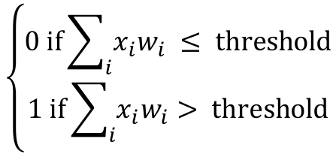
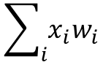
Perceptrons
Proposed by Frank Rosenblatt in early 1960s
First type of `artificial neuron`
Takes n inputs x_{1 …} x_{n}
Generates one binary output
x₁
x₂
x₃
x₄
…
x_{n}
w₁
w₂
$$\left\{\begin{aligned}0 \text{if}\sum_{i}{x_{i}w_{i}} ≤ \text{threshold} \\ 1 \text{if}\sum_{i}{x_{i}w_{i}}> \text{threshold}\end{aligned}\right.$$
w₃
$$\sum_{i}{x_{i}w_{i}}$$
w₄
output
w_{n}

Slide 5
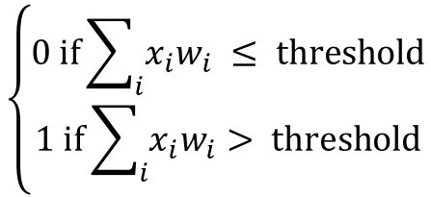
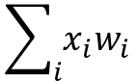
Perceptrons
A molecular example, using this molecule:
Should I have more coffee?
Output is 0 (no) or 1 (yes)
Inputs
Is it not yet the sleepy time? (x1 = 0 or 1)
Has it been two hours since my last coffee? (x2 = 0 or 1)
Am I going for coffee with one of you in DSMCER class? (x3 = 0 or 1)
Earlier than 4 pm? x₁
Last coffee > 2 hrs? x₂
DSMCERer? x₃
$$\left\{\begin{aligned}0 \text{if}\sum_{i}{x_{i}w_{i}} ≤ \text{threshold} \\ 1 \text{if}\sum_{i}{x_{i}w_{i}}> \text{threshold}\end{aligned}\right.$$
$$\sum_{i}{x_{i}w_{i}}$$
output
w₁ = ?
w₂ = ?
w₃ = ?
threshold = ?

Slide 6
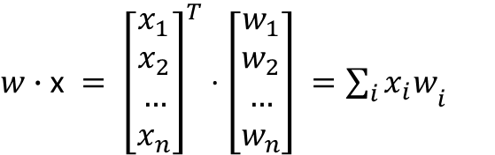
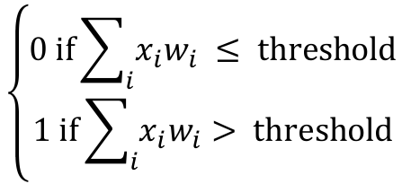
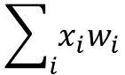
Recall…
Linear algebra: dot product of two vectors
In the context of a perceptron
$w∙\text{x} = {\left[\begin{aligned}x_{1} \\ x_{2} \\ … \\ x_{n}\end{aligned}\right]}^{T}⋅\left[\begin{aligned}w_{1} \\ w_{2} \\ … \\ w_{n}\end{aligned}\right] ={\sum_{i}{x_{i}w}}_{i}$
x₁
x₂
x₃
x₄
…
x_{n}
w₁
w₂
$$\left\{\begin{aligned}0 \text{if}\sum_{i}{x_{i}w_{i}} ≤ \text{threshold} \\ 1 \text{if}\sum_{i}{x_{i}w_{i}}> \text{threshold}\end{aligned}\right.$$
w₃
$$\sum_{i}{x_{i}w_{i}}$$
w₄
output
w_{n}

Slide 7
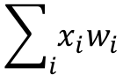
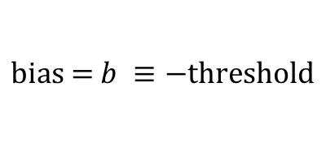
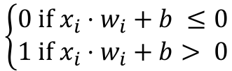
Modifying the perceptron
Let’s rewrite the perceptron equation in terms of bias
Bias is effectively how easy it is to trigger a 1 (or fire)
$$\text{bias}\text{ = }b ≡−\text{threshold}$$
x₁
x₂
x₃
x₄
…
x_{n}
w₁
w₂
w₃
$$\sum_{i}{x_{i}w_{i}}$$
$$\left\{\begin{aligned}0 \text{if} x_{i}⋅w_{i}+b ≤0 \\ 1 \text{if} x_{i}⋅w_{i}+b> \text{0}\end{aligned}\right.$$
w₄
output
w_{n}

Slide 8
Multilayer Perceptron
We can layer perceptrons
Note: for each perceptron there is still only one output, but it is fed into multiple other perceptrons in the next layer.

Slide 9
Multilayer Perceptron
We can layer perceptrons
Layer 1 makes very simple decisions based on the raw inputs.
Layer 2 makes abstract and complex decisions based on the layer 1’s results.
Can layer 2 access the raw inputs?

Slide 10
Multilayer Perceptron
We can layer perceptrons
In literature, inputs are treated as a layer itself

Slide 11
Multilayer Perceptron
We can layer perceptrons
The middle layers are ‘hidden’
The output is a layer and may contain multiple nodes
Hidden layers

Slide 12
Multilayer Perceptron
Learning with MLPs
If our output is incorrect by some Δoutput
Ideally we want to find a Δw_{i} that modifies output
In practice this is hard. Why?
Hint:
Random internet image

Slide 13
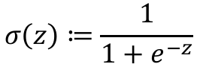
The sigmoid function
What if we had a smoother transition?
The sigmoid function (also used in logistic reg.)
Outputs only values from 0 to 1
Monotonic, increasing, differentiable
$$σ\left(z\right)≔\frac{1}{1+e^{−z}}$$
Wikipedia

Slide 14
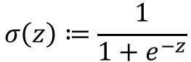
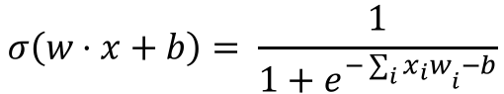
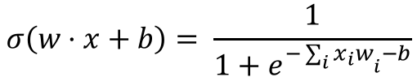
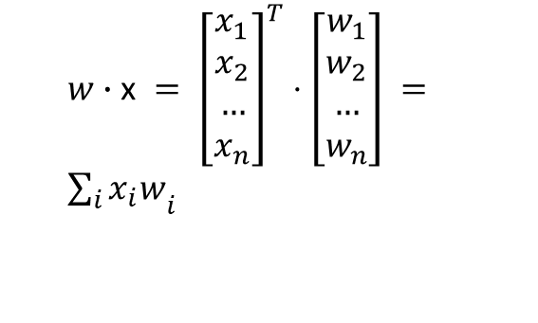
Sigmoid neuron
Use the sigmoid as out activation function
$w∙\text{x} = {\left[\begin{aligned}x_{1} \\ x_{2} \\ … \\ x_{n}\end{aligned}\right]}^{T}⋅\left[\begin{aligned}w_{1} \\ w_{2} \\ … \\ w_{n}\end{aligned}\right] ={\sum_{i}{x_{i}w}}_{i}$
$$σ\left(z\right)≔\frac{1}{1+e^{−z}}$$
$$σ\left(w⋅x+b\right)= \frac{1}{1+e^{−{\sum_{i}{x_{i}w}}_{i}−b}}$$
x₁
x₂
x₃
x₄
…
x_{n}
w₁
w₂
w₃
$$σ\left(w⋅x+b\right)= \frac{1}{1+e^{−{\sum_{i}{x_{i}w}}_{i}−b}}$$
w₄
output
w_{n}

Slide 15
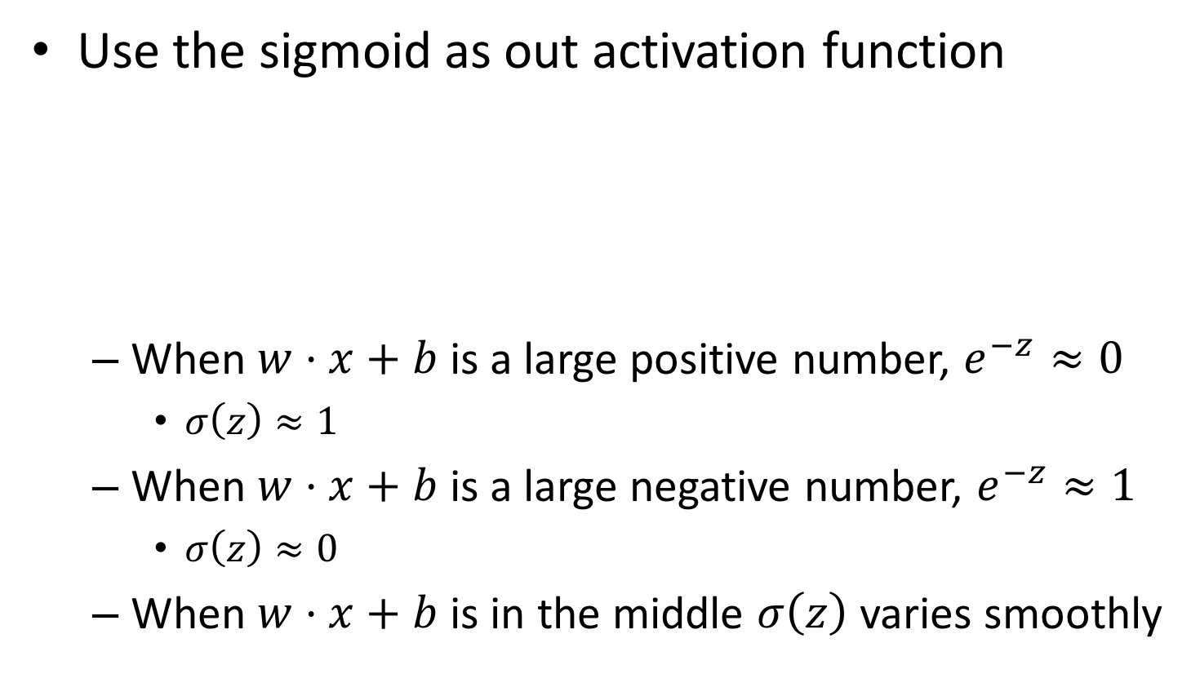
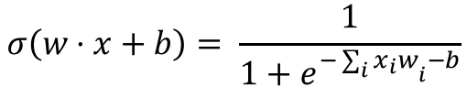
Sigmoid neuron
Use the sigmoid as out activation function
When $w⋅x+b$ is a large positive number, $e^{−z}≈0$
$σ\left(z\right)≈1$
When $w⋅x+b$ is a large negative number, $e^{−z}≈1$
$σ\left(z\right)≈0$
When $w⋅x+b$ is in the middle $σ\left(z\right)$ varies smoothly
x₁
x₂
x₃
x₄
…
x_{n}
w₁
w₂
w₃
$$σ\left(w⋅x+b\right)= \frac{1}{1+e^{−{\sum_{i}{x_{i}w}}_{i}−b}}$$
w₄
output
w_{n}

Slide 16
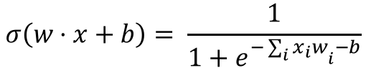
Neural network
We can layer sigmoid neurons
x₁
x₂
x₃
x₄
…
x_{n}
w₁
w₂
w₃
$$σ\left(w⋅x+b\right)= \frac{1}{1+e^{−{\sum_{i}{x_{i}w}}_{i}−b}}$$
w₄
output
w_{n}

Slide 17
Neural network
This is a strictly ‘feed forward network’
Layers only propagate forward in the hierarchy

Slide 18
Neural network
Recurrent neural networks allow loops
Loops allow for time delays
Can be used for sequence prediction
Not just in time
Protein / DNA sequence, i.e.
Heteropolymer sequence
Structural states
…
Elman network, wikipedia

Slide 19
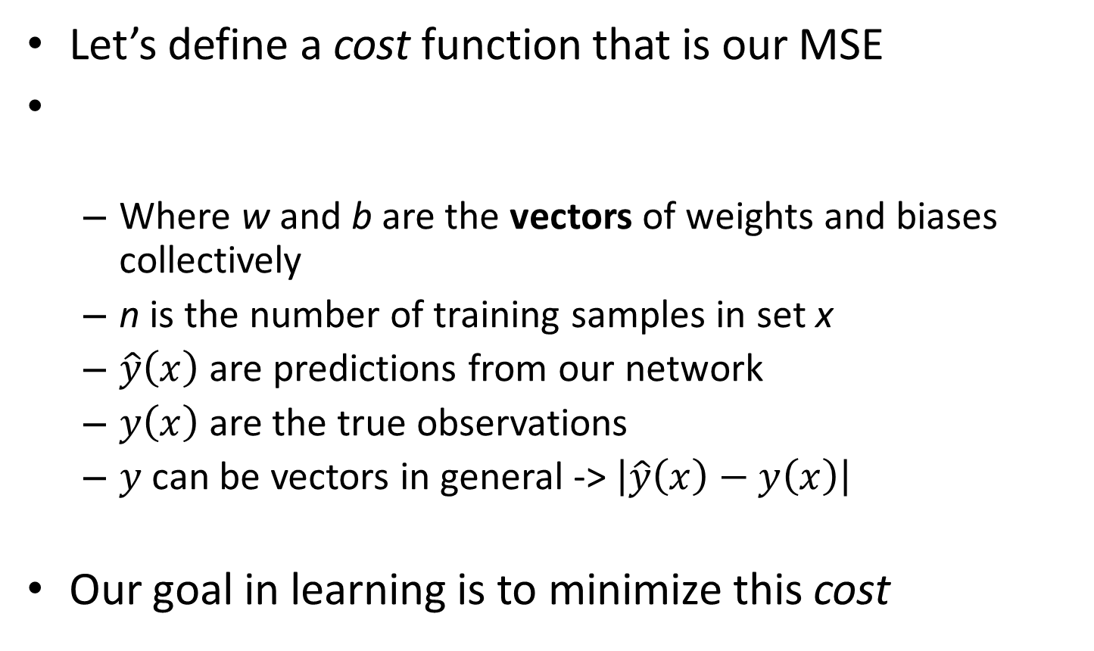
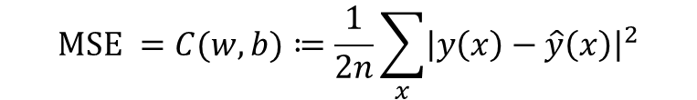
Learning in neural networks
Let’s define a cost function that is our MSE
Where w and b are the vectors of weights and biases collectively
n is the number of training samples in set x
$\hat{y}\left(x\right)$ are predictions from our network
$y\left(x\right)$are the true observations
$y$ can be vectors in general -> $\left|\hat{y}\left(x\right)−y\left(x\right)\right|$
Our goal in learning is to minimize this cost
$$\text{MSE} =C(w,b)≔\frac{1}{2n}\sum_{x}{{\left|y\left(x\right)−\hat{y}\left(x\right)\right|}^{2}}$$
Notes:
1/2n makes this a quadratic cost function

Slide 20
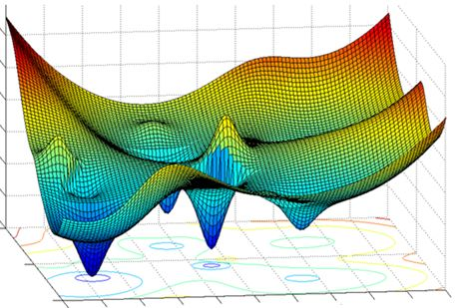
Learning in neural networks
Our goal in learning is to minimize the C function
We have analytical, differential forms for all components
Find an analytical solution!
Can be very complicated in general

Slide 21
Learning in neural networks
Our goal in learning is to minimize the C function
Gradient descent methods are used
Iterative process
Numerically compute the gradients of each component of w and b vectors relative to C
Select the component with the largest gradient
Change it by some value 𝜀
Rinse – repeat until converged
Backpropagation
Partial differential of C with respect to w & b

Slide 22
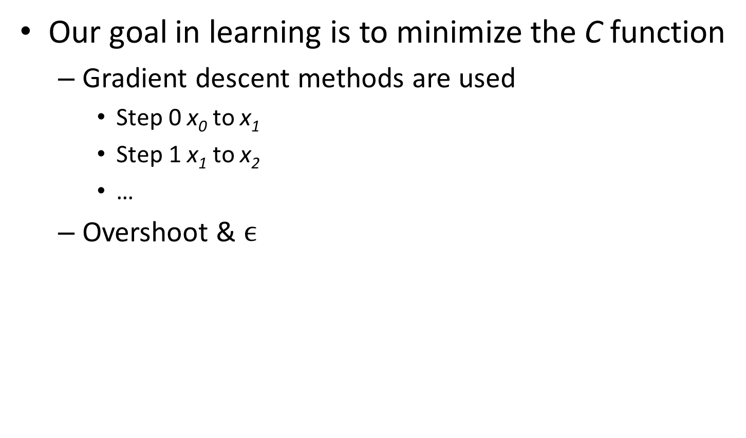
Learning in neural networks
Our goal in learning is to minimize the C function
Gradient descent methods are used
Step 0 x₀ to x₁
Step 1 x₁ to x₂
…
Overshoot & $ϵ$
wikipedia

Slide 23
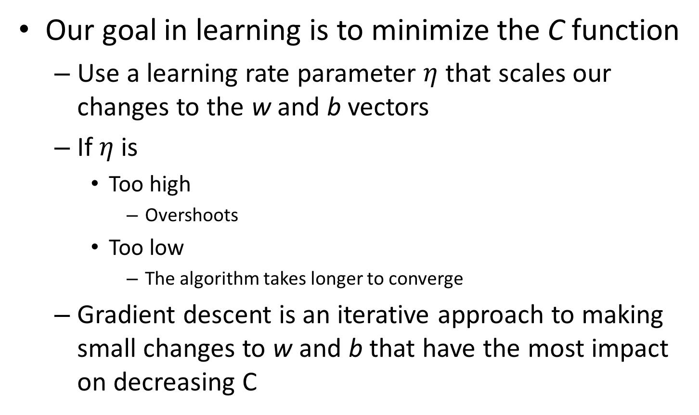
Learning in neural networks
Our goal in learning is to minimize the C function
Use a learning rate parameter $η$ that scales our changes to the w and b vectors
If $η$ is
Too high
Overshoots
Too low
The algorithm takes longer to converge
Gradient descent is an iterative approach to making small changes to w and b that have the most impact on decreasing C

Slide 24
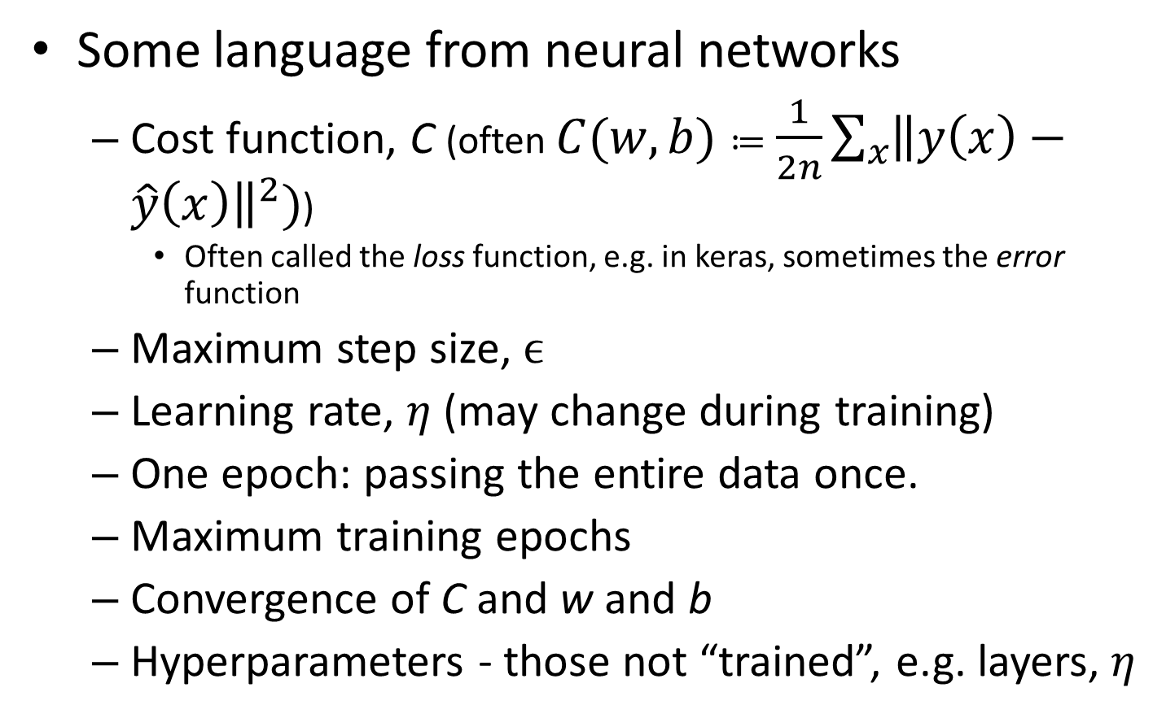
Learning in neural networks
Some language from neural networks
Cost function, C (often $C(w,b)≔\frac{1}{2n}\sum_{x}{{\left\|y\left(x\right)−\hat{y}\left(x\right)\right\|}^{2}})$)
Often called the loss function, e.g. in keras, sometimes the error function
Maximum step size, $ϵ$
Learning rate, $η$ (may change during training)
One epoch: passing the entire data once.
Maximum training epochs
Convergence of C and w and b
Hyperparameters - those not “trained”, e.g. layers, $η$
Notes:
Iteration, batch-size, epoch

Slide 25
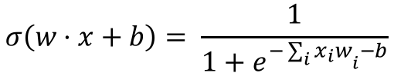
Limitations of sigmoids
Learning slows down at sigmoid asymptotes
The partial differential of C with respect to w & b is very small near 0 and 1
Large changes in w_{i} & b_{i} have little effect on C
$$σ\left(w⋅x+b\right)= \frac{1}{1+e^{−{\sum_{i}{x_{i}w}}_{i}−b}}$$
Another solution…. Change the cost function!

Slide 26
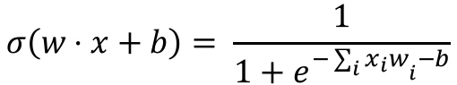
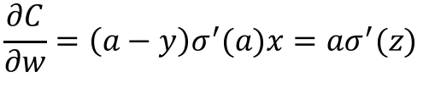
Limitations of sigmoids
Learning slows down at sigmoid asymptotes
$$σ\left(w⋅x+b\right)= \frac{1}{1+e^{−{\sum_{i}{x_{i}w}}_{i}−b}}$$
$$\frac{∂C}{∂w}=\left(a−y\right)σ^{′}(a)x=aσ^{′}(z)$$
Derivative of σ @ z
Also known as saturation or vanishing gradient problem.

Slide 27
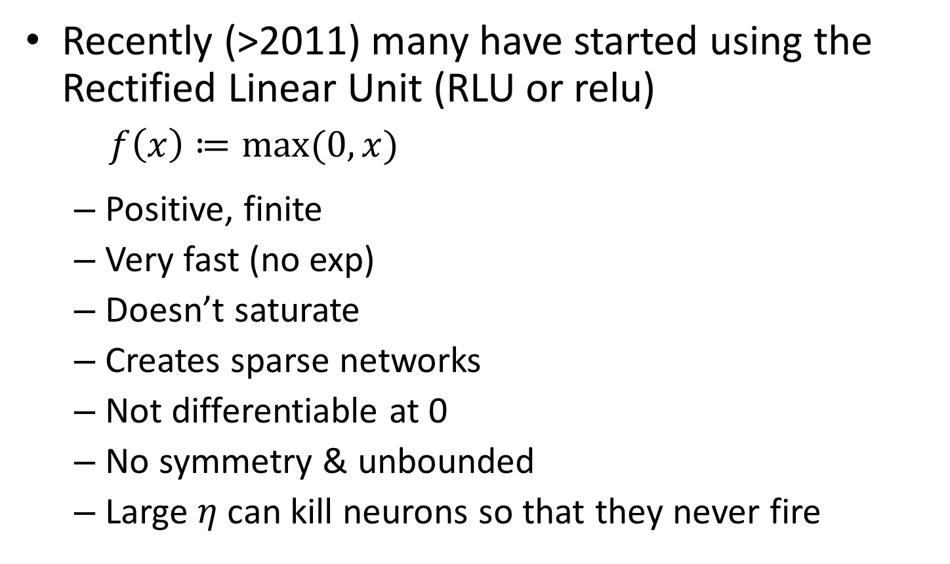
Activation alternatives
Recently (>2011) many have started using the Rectified Linear Unit (RLU or relu)
$f\left(x\right)≔\max_{}{(0, x)}$
Positive, finite
Very fast (no exp)
Doesn’t saturate
Creates sparse networks
Not differentiable at 0
No symmetry & unbounded
Large $η$ can kill neurons so that they never fire
Wikipedia

Slide 28
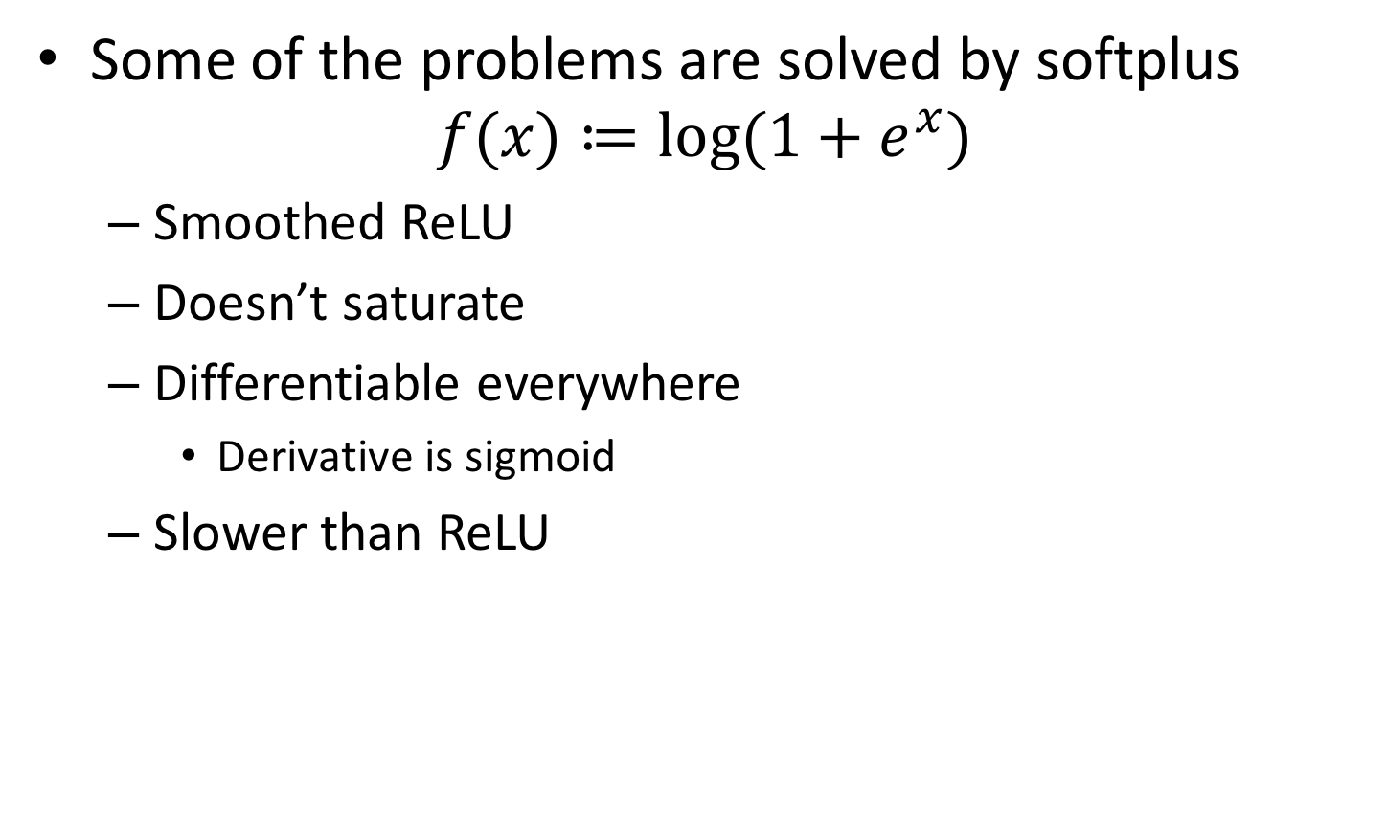
Activation alternatives
Some of the problems are solved by softplus
$$f(x)≔log⁡(1+e^{x})$$
Smoothed ReLU
Doesn’t saturate
Differentiable everywhere
Derivative is sigmoid
Slower than ReLU
Wikipedia

Slide 29
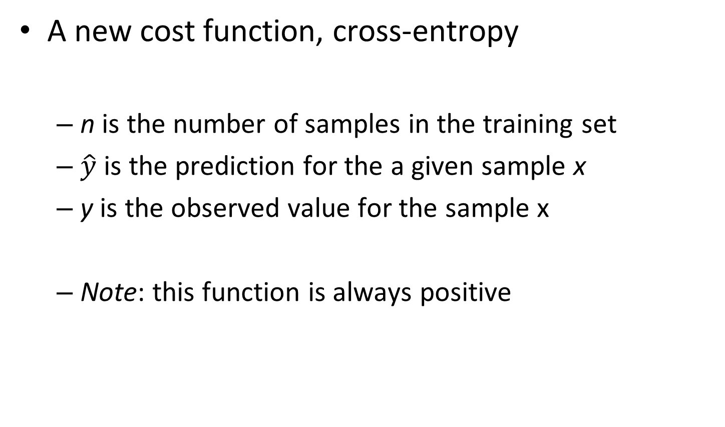
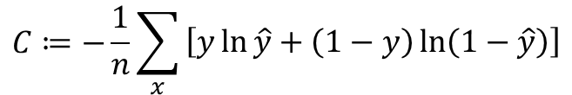
A better cost function
for classification
A new cost function, cross-entropy
n is the number of samples in the training set
$\hat{y}$ is the prediction for the a given sample x
y is the observed value for the sample x
Note: this function is always positive
$$C≔−\frac{1}{n}\sum_{x}{\begin{aligned}\left[y\ln{\hat{y}}+\left(1−y\right)\ln\left(1−\hat{y}\right)\right]\end{aligned}}$$

Slide 30
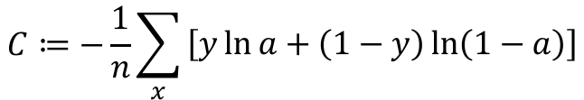
A better cost function
for classification
A new cost function, cross-entropy
How is this a cost function?
When y and a are about equal and close to 0
The first term vanishes as does the second
When y and a are about equal and close to 1
The first term vanishes as does the second
Thus, cross-entropy cost is positive and drives to 0 as the predictions approximate the training observations
$$C≔−\frac{1}{n}\sum_{x}{\begin{aligned}\left[y\ln{a}+\left(1−y\right)\ln\left(1−a\right)\right]\end{aligned}}$$
(0 * ln(anything) = 0)
(anything * ln(1) = 0)

Slide 31
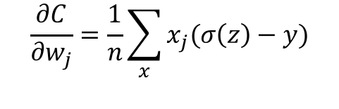
A better cost function
for classification
Why is this cost function better?
The partial derivatives of C with respect to w and b contain no reference to the sigmoid function!
$$\frac{∂C}{∂w_{j}}=\frac{1}{n}\sum_{x}{x_{j}(σ\left(z\right)−y)}$$
Note: dependence only on error in output and not derivative of sigmoid!

Slide 32
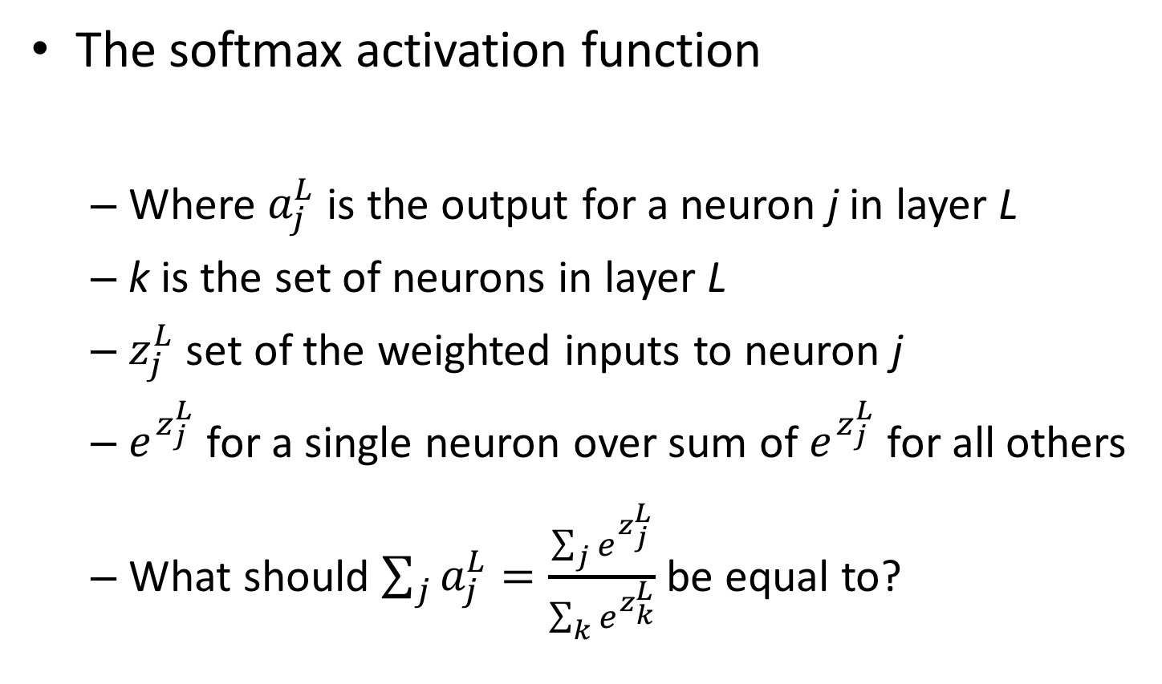
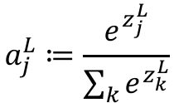
Another output function
The softmax activation function
Where $a_{j}^{L}$ is the output for a neuron j in layer L
k is the set of neurons in layer L
$z_{j}^{L}$ set of the weighted inputs to neuron j
$e^{z_{j}^{L}}$ for a single neuron over sum of $e^{z_{j}^{L}}$ for all others
What should $\sum_{j}{a_{j}^{L}}=\frac{\sum_{j}{e^{z_{j}^{L}}}}{\sum_{k}{e^{z_{k}^{L}}}}$ be equal to?
$$a_{j}^{L}≔\frac{e^{z_{j}^{L}}}{\sum_{k}{e^{z_{k}^{L}}}}$$
1

Slide 33
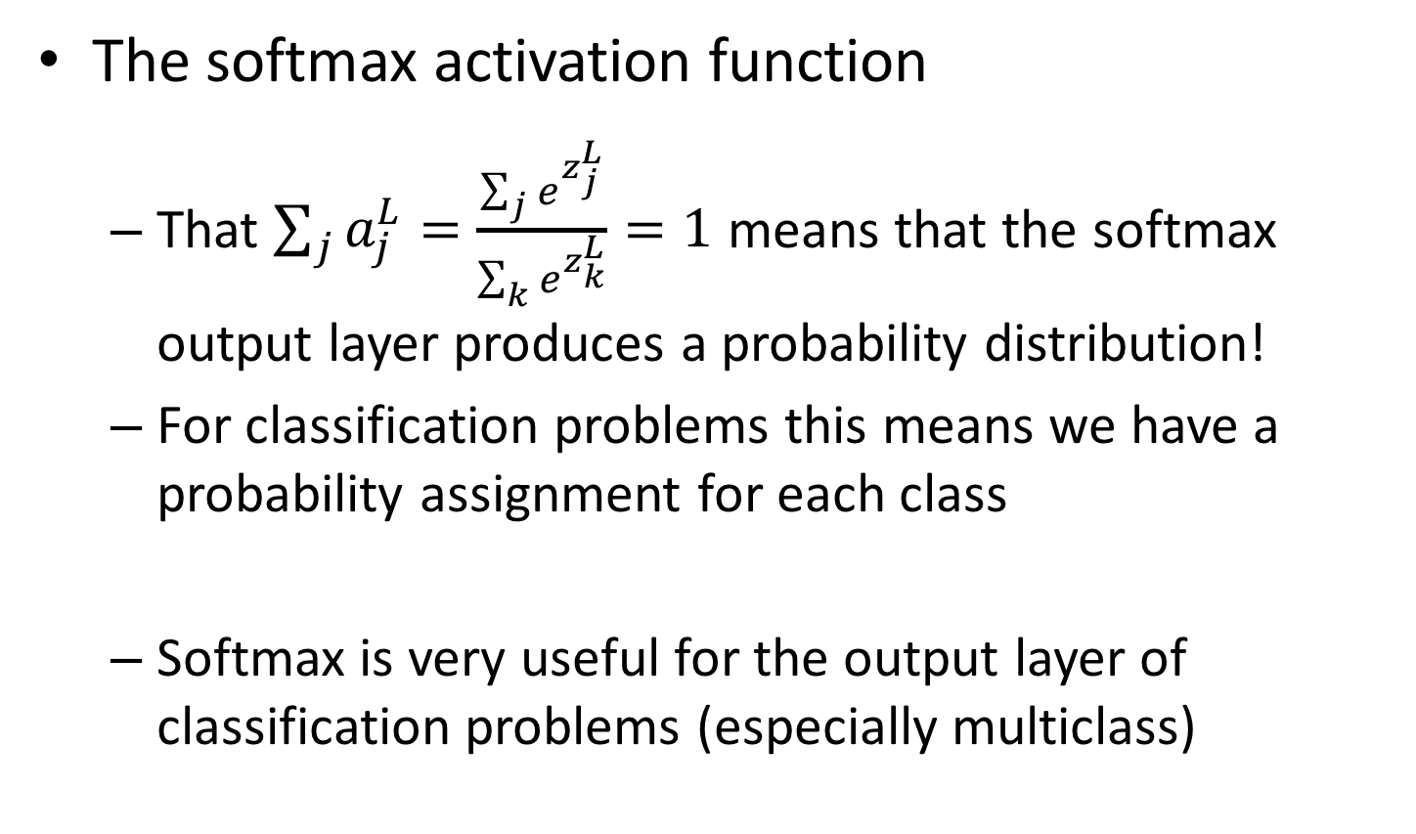
Another output function
The softmax activation function
That $\sum_{j}{a_{j}^{L}}=\frac{\sum_{j}{e^{z_{j}^{L}}}}{\sum_{k}{e^{z_{k}^{L}}}}=1$ means that the softmax output layer produces a probability distribution!
For classification problems this means we have a probability assignment for each class
Softmax is very useful for the output layer of classification problems (especially multiclass)
NEAT!

Slide 34
Monitoring training
With NN, we still do a test-train split
It is useful to plot the cost function or classification accuracy
Over training epochs
For train and validation
Data from keras on first 100k records in HCEPDB using only input and output layer.

Slide 35
Questions?

Slide 36
Python time! WEEEE!
Grab the Python notebook from the syllabus
Run `jupyter notebook` in your virtual environment
conda create -n keras
source activate keras
conda install -c conda-forge keras
conda install ipython
conda install jupyter
conda install pandas
conda install scipy
conda install seaborn
conda install scikit-learn

